Slide 1
Project evaluation and planning
Unit -1

Slide 2
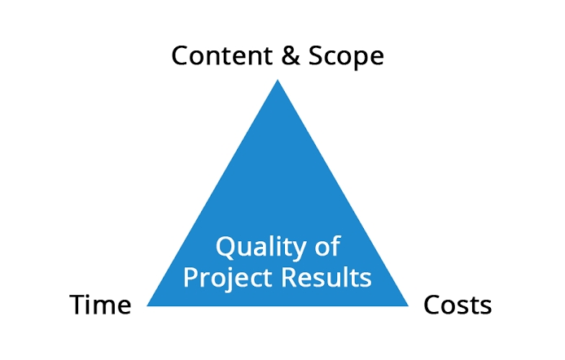
Importance of software project management :
It is an essential part of software organization to deliver quality product, keeping the cost within client's budget constrain and deliver the project as per scheduled.

Slide 3
Methodologies:
A project management methodology is a system of principles, techniques, and procedures used by those who work in a discipline. Not only do the top methodologies differ in how they're structurally organized, but they also require different deliverables, workflows, and even project management software development.
Specific examples of project management methodologies – each with its unique advantages and limitations – include, but are not limited to Agile, Waterfall, Critical Path, Scrum, Lean Six Sigma and PRINCE2.

Slide 4
Categorization of software projects:
Projects are often categorized on the basis of their scope, size, speed of implementation, location, type, and technology.
There are three broad categories of projects to consider: Strategic Projects, Operational Projects, and Compliance Projects.

Slide 5
Setting objectives:
Project management objectives are the successful development of project's phases including initiation, planning , execution, monitoring and closing.
How do you set objectives in software project management?
Procedures
Understand the mission of the enterprise or of the project.
Brainstorm desired results and other accomplishments.
Develop and document specific objective statements.
Ratify objectives (prioritize if required).
Reach consensus and obtain approval from the sponsor (as required).

Slide 6
Management principles:
Formal project management structure
Invested and engaged project sponsor
Clear and objective goals and outcomes
Documented roles and responsibilities
Strong change management
Risk management
Mature value delivery capabilities
Performance management baseline
Communication plan

Slide 7
Management control:
Project controls are a set of processes used to understand and influence the amount of time or money spent on a project. Each project control focuses on a distinct part of the project plan, like the schedule, resources, or potential risks.

Slide 8
Project portfolio management:
Project portfolio management provides high levels of visibility both from a strategic and a tactical perspective. It provides insights into past project metrics such as project costs, profitability, duration, quality, and resource usage.

Slide 9
Cost benefit evaluation Technology
This method compares the total costs of a programme/project with its benefits, using a common metric (most commonly monetary units), which enables you to calculate the net cost or benefit associated with the programme.

Slide 10
Risk evaluation:
Anyone responsible for a company's data, server, network, or software must perform a risk evaluation. A risk evaluation can help determine if those assets are at risk for a cyberattack, virus, data loss through natural disaster, or any other threat.

Slide 11
Strategic program management:
Strategic program management identifies and implements the organisation's long-terms goals and objectives into the project.
Five Tasks of Strategic Management
Developing a Strategic Vision and Mission.
Setting Objectives.
Crafting a Strategy.
Implementing the Strategy.
Evaluating Performance and Initiating Corrective Adjustments.

Slide 12
Stepwise project planning:
Break the project into a list of deliverables.
Talk to your team.
Identify risks.
Create a budget.
Add milestones.
Set progress reporting guidelines.

